Slide 1


3D Graphics
Workshop 12 – Coursera week 13 and 14

Slide 2
The GPU
CPU
Current CPU as up to 18 cores.
Each core can process instruction line by line
Large and board instruction sets
GPU
Massive parallelism. Current GPU has up to 4000 cores
Limited instruction sets
Most instruction sets are graphic processing related
https://www.omnisci.com/technical-glossary/cpu-vs-gpu
Watch the Video on the differences between CPU and CPU
https://www.youtube.com/watch?v=-P28LKWTzrI&t=3s

Slide 3
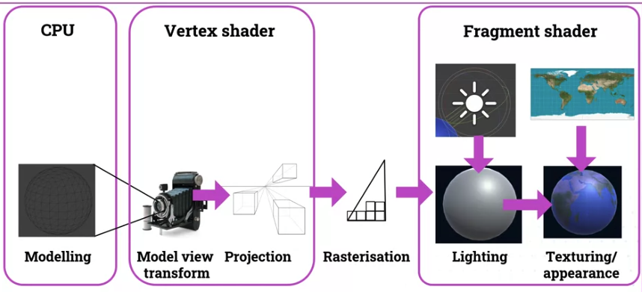
GPU Shader in graphics pipeline

Slide 4
Shader – Basic idea
Vertex shader works on each vertex.
A single Polygon is made up of 3 vertices.
It has information such as position, normal etc..

Slide 5
Shader – Basic idea
Vertex shader can pass variables (Varying) to each fragment.
The variables that are passed to each fragment are “interpolated” automatically.

Slide 6
Shader – Basic idea
Fragment shader works on each fragment using the variable passed in.

Slide 7
Shader – types of variable
Uniform
All vertices get the same value
For example:
ModelView matrix
Projecttion matrix
Attributes
Value is specific to that vertex
For example:
Vertex position

Slide 8
Shader – types of variable
Varying
Output variables from the Vertex shader to the Fragment shader
The value is interpolated in the rasterization face.

Slide 9
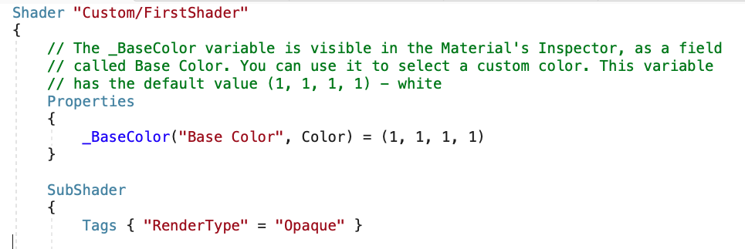
Unity Shader program structure
Unity Specific

Slide 10
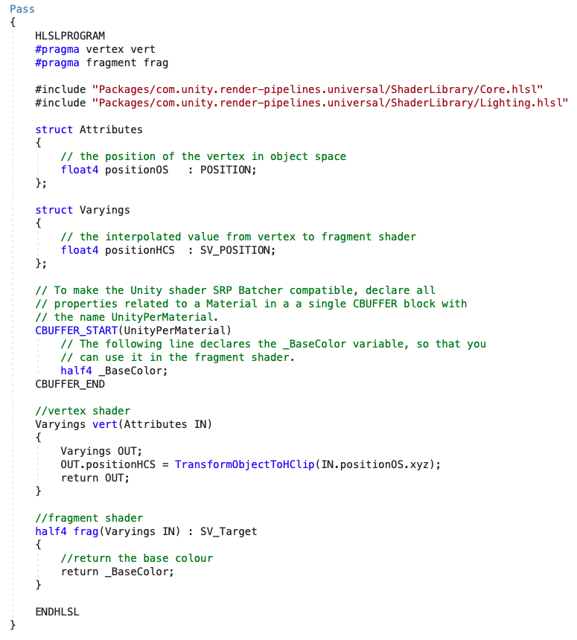
Unity Shader program structure
HLSL shader code

Slide 11
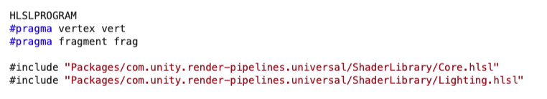
Unity Shader program structure
Preprocessor
Need to install Core RP and Universal RP
RP – Rendering Pipeline

Slide 12
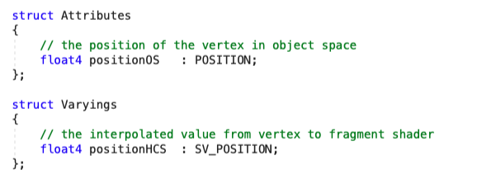
Unity Shader program structure
Attributes and Varyings struct.
Struct -> structure, think of it as a class without method.

Slide 13
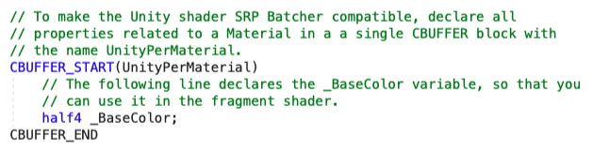
Unity Shader program structure
CBUFFER

Slide 14
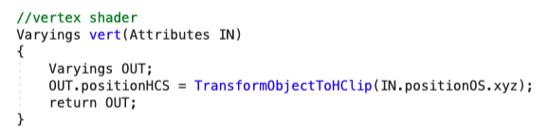
Unity Shader program structure
Vertex Shader

Slide 15
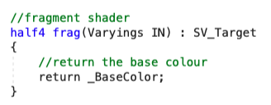
Unity Shader program structure
Fragment Shader

Slide 16
Lab
Work on Workshop 12 Lab 1.
In this activity, we are going to implement a few simple Vertex and Fragment Shader.

